Slide 1
Java Database Programming
Le Hong Hai
UET-VNUH

Slide 2
Relational Database and and Structure Query Language (SQL)
[Skip if you are familiar with SQL.]
A relational database organizes data in tables. A table has rows (records) and columns (fields). Tables can be related to eliminate data redundancy and to ensure data integrity
A high-level language called Structure Query Language (SQL) can be used for structuring, querying and modifying the data in a relational database
SQL defines a set of commands, such as SELECT, INSERT, UPDATE, DELETE, CREATE TABLE, DROP TABLE..

Slide 3
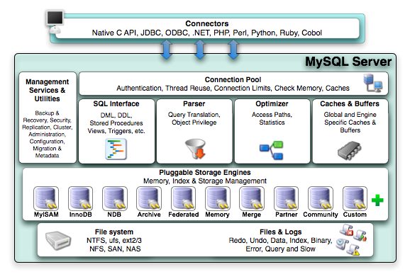
MySQL Server

Slide 4
Java Database Connectivity (JDBC)
JDBC allows us to connect our Java programs to a database
JDBC can work with a variety of different types of databases. A JDBC Driver connects Java to a particular type of database

Slide 5
JDBC Driver for MySQL
In our case, we’ll need a JDBC driver for MySQL. We will use the Connector/J driver from MySQL.com available at: http://www.mysql.com/products/connector/

Slide 6
Basic JDBC Programming
A JDBC (Java Database Connectivity) program (in JDK 6 and above) has the following 5 steps:
  Step 1: Create a Connection object, for connecting to the database
  Step 2: Create a Statement object, within the Connection object created.
  Step 3: Execute a SQL query
  Step 4: Process the query result
  Step 5: Free up the resources by closing the Statement and Connection object

Slide 7
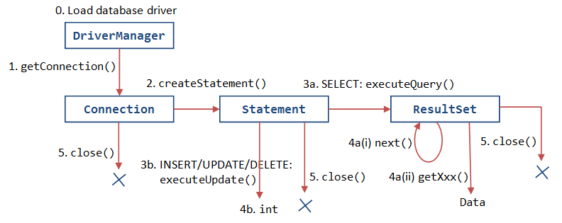
JDBC Cycle

Slide 8
1. Establish a connection
import java.sql.*;
Load the vendor specific driver
  Class.forName("com.mysql.jdbc.Driver");
    Dynamically loads a driver class, for MySQL database
Make the connection
  Connection con = DriverManager.getConnection( "jdbc:mysql://" + server, account, password);
  Establishes connection to database by obtaining
  a Connection object

Slide 9
2. Create JDBC statement(s)
Statement stmt = con.createStatement() ;
Creates a Statement object for sending SQL statements to the database

Slide 10
3.1 Executing SQL Statements
String sqlStr = "select title, price, qty from books";
ResultSet rset = stmt.executeQuery(sqlStr);

Slide 11
3.2 Updating vs. Querying
String sqlStr = "update books set price = 12.34, qty = 88 where id = 1001";
int count = stmt.executeUpdate(sqlStr);
which returns an int indicating the number of records affected

Slide 12
4. Get ResultSet
System.out.println("The records selected are:");
int rowCount = 0;
while(rset.next()) { // Move the cursor to the next row String title = rset.getString("title");
double price = rset.getDouble("price");
int qty = rset.getInt("qty");
System.out.println(title + ", " + price + ", " + qty); rowCount++;
}
System.out.println("Total number of records = " + rowCount);
Use rset.wasNull() to check if a field value is NULL

Slide 13
5. Close connection
stmt.close();
con.close();

Slide 14
Transactions and JDBC
JDBC allows SQL statements to be grouped together into a single transaction
We can turn off the auto-commit mode with con.setAutoCommit(false); and turn it back on with con.setAutoCommit(true);
Once auto-commit is off, no SQL statement will be committed until an explicit is invoked con.commit();
At this point all changes done by the SQL statements will be made permanent in the database

Slide 15
Handling Errors with Exceptions
Programs should recover and leave the database in a consistent state.
If a statement in the try block throws an exception or warning, it can be caught in one of the corresponding catch statements
E.g., you could rollback your transaction in a
catch { …} block or close database connection and free database related resources in finally {…} block

Slide 16
JDBC Transaction Example
Connection conn = null;
Statement stmt = null;
try {
  conn = DriverManager.getConnection( "jdbc:mysql://127.0.0.1:8888/ebookshop", "myuser", "xxxx"); // MySQL stmt = conn.createStatement();
  conn.setAutoCommit(false); // Issue two INSERT statements stmt.executeUpdate("INSERT INTO books VALUES (5501, 'Peter', 'Mahjong 101', 5.5, 5)");
  // Duplicate primary key, which triggers a SQLException stmt.executeUpdate("INSERT INTO books VALUES (5501, 'Peter', 'More Mahjong', 6.6, 6)");
  conn.commit(); // Commit changes only if all statements succeed.
} catch(SQLException ex) {
System.out.println("-- Rolling back changes --");
conn.rollback(); // Rollback to the last commit. ex.printStackTrace();
} finally { // Step 5: Free resources
if (stmt != null) stmt.close();
if (conn != null) conn.close();
}

Slide 17
PreparedStatement
JDBC provides a class called PreparedStatement, which allows you to pass parameters to a SQL statement and execute the same SQL statement multiple times
A PreparedStatement is a pre-compiled SQL statement that is more efficient than calling the same Statement over and over. In a PreparedStatement, '?' indicates a place holder for parameter
A set of setXxx(placeHolderNumber, value) methods can be used to fill in the parameters
Prevent SQLInjection

Slide 18
PreparedStatement Example
pstmt = conn.prepareStatement( "insert into books values (?, ?, ?, ?, ?)"); // Five parameters 1 to 5
pstmt.setInt(1, 3001); // Set values for parameters 1 to 5 pstmt.setString(2, "Mahjong 101");
pstmt.setString(3, "Kumar");
pstmt.setDouble(4, 88.88);
pstmt.setInt(5, 88);
int rowAffected = pstmt.executeUpdate(); // Execute statement
System.out.println(rowAffected + "rows affected");
pstmt.setInt(1, 3002); // Change values for parameters 1 and 2
pstmt.setString(2, "Mahjong 202"); // No change in values for parameters 3 to 5
rowAffected = pstmt.executeUpdate(); System.out.println(rowAffected + "rows affected");

